Slide 1
The White Rose
Student Resistance in Nazi Germany
Munich & beyond

Slide 2
Acknowledgements
Thanks to Inge Scholl (1917-98) (Sophie and Hans Scholl’s older sister), Otl Aicher, a friend of the Scholl’s and husband of Inge Scholl and Walter Schwaiger.
Otl Aicher: Otto "Otl" Aicher (13 May 1922 – 1 September 1991) was a German graphic designer and typographer. He is best known for having designed pictograms for the 1972 Summer Olympics in Munich that proved influential on the use of stick figuresfor public signage, as well as designing the typeface Rotis. Aicher also co-founded the Ulm School of Design.

Slide 3
Where does “White Rose” come from?
The White Rose (active 1942 to 1943)
From the court documents prosecuting Hans Scholl: “According to the defendant Hans Scholl, the name ‘The White Rose’ was chosen ‘at random’ and inspired by having read a ‘Spanish’ novel of the same name.”
Presumably B. Traven’s novel The White Rose

Slide 4
Vergangenheitsbewältigung & Weltanschauung
Dr Robert Knight “The Sixth University of Glasgow Holocaust Memorial Lecture”
(24 January 2006 )
“What do we mean by ‘coming to terms with the past’? The phrase is one current translation of the German term ‘Vergangenheits-bewältigung’ a composite noun comprising ‘Vergangenheit’ ( = past) and ‘Bewältigung’ (= coming to terms). It probably entered English as a direct translation of the German in the 1960s. However, ‘coming to terms’ is not the only available translation of ‘Bewältigung’ - alternative current translations include ‘tackling, confronting or facing up to.’ […] Clearly, we cannot be “reconciled” to the past such as the Holocaust.

Slide 5
And why do I mention …
Weltanschauung?
Vicki Lawrence speaks of the “Gnade der spät geborenen” – the grace of being born too late, too late, that is, to having been burdened first hand with responsibility for the horrors of the Holocaust.

Slide 6
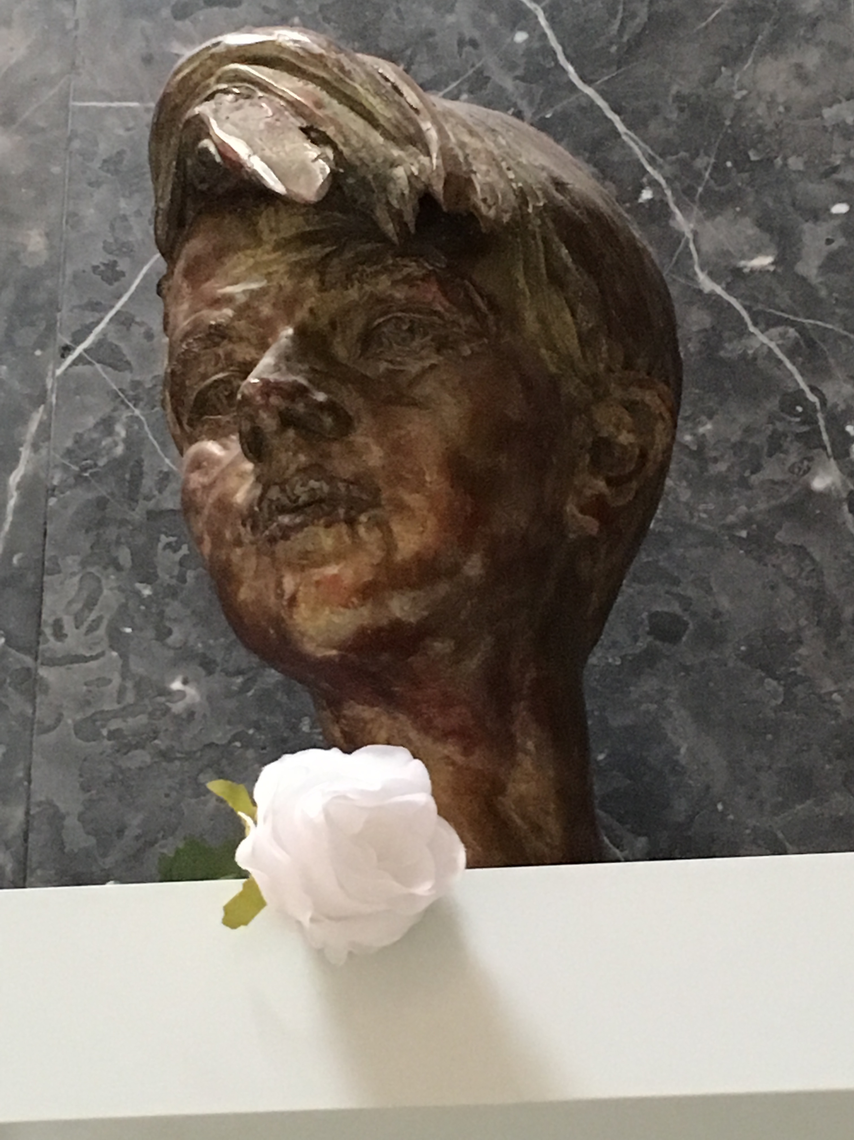
Sophie Scholl
Memorial at
Munich University

Slide 7
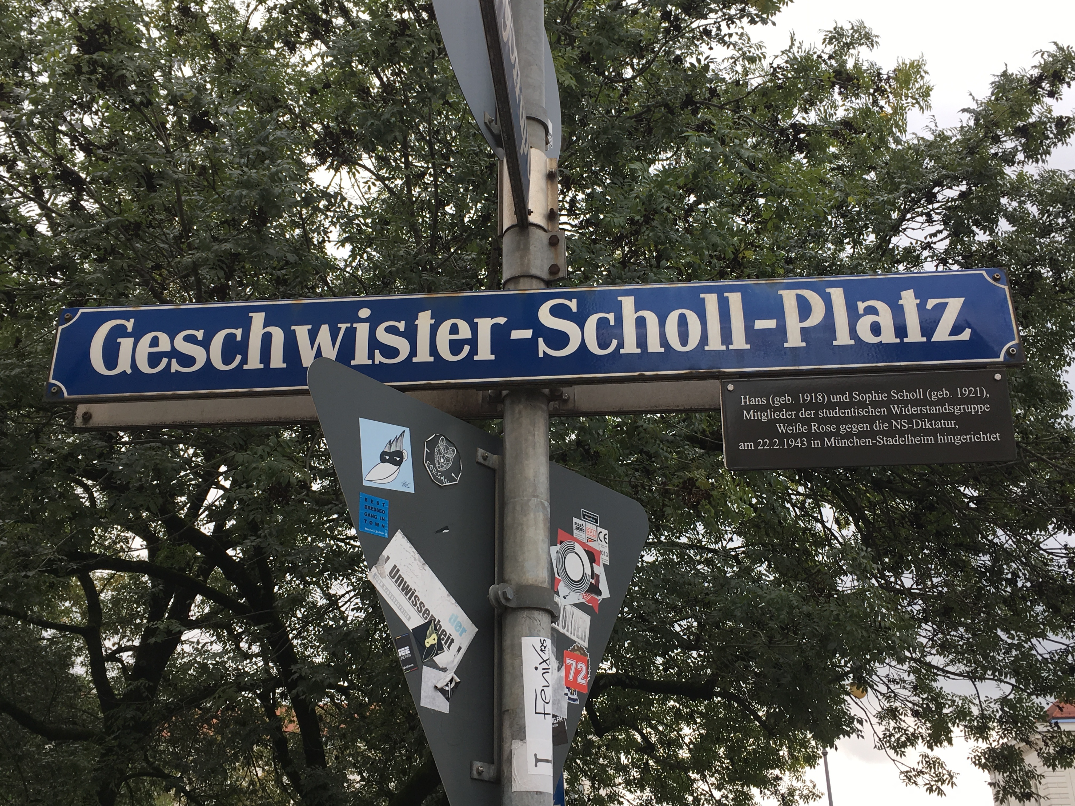

Slide 8
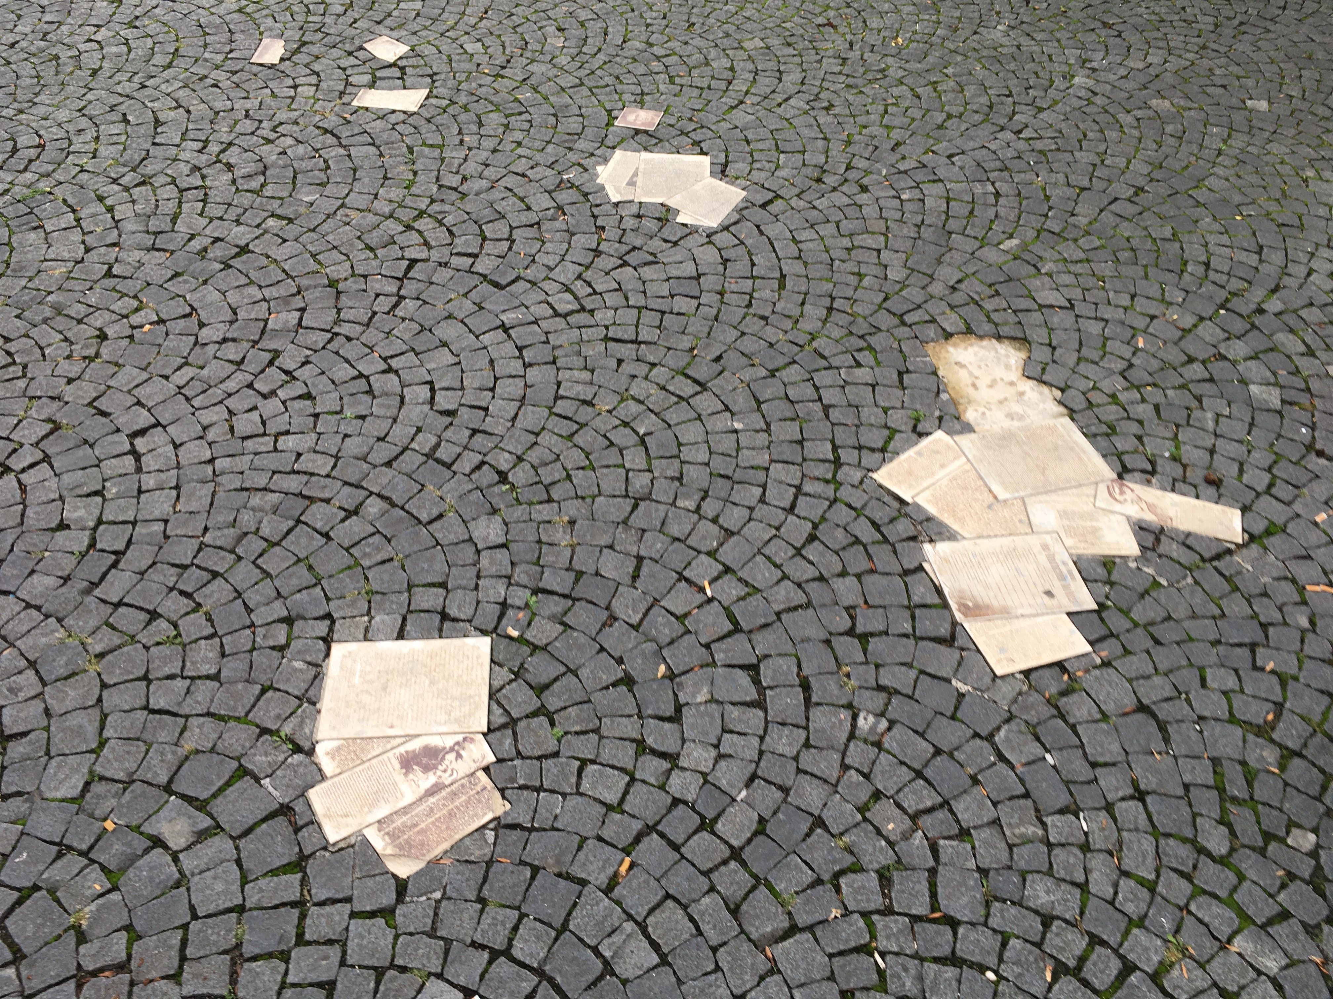

Slide 9
What was the Hitler Youth
On 1 December 1936, the law on the formation of the Hitler Youth was introduced, basically stating that the future of the German people rests with the youth. All German youth were to be gathered in the compulsory Hitler Youth movement. Outside of homelife and school life, every young person in Germany was to be “educated” in the Hitler Youth. By 1938, 8.7 million girls and boys were members of the Hitler Youth.

Slide 10
Munich University during the Nazi Era
After the rise to power, the Nazi regime banned all student associations in 1933. On April 7, 1933, Jewish professors and nearly all independent researchers are removed from the university, which loses its independent charter in 1934. Henceforth the Reichsministerium takes over the running of the university.

Slide 11
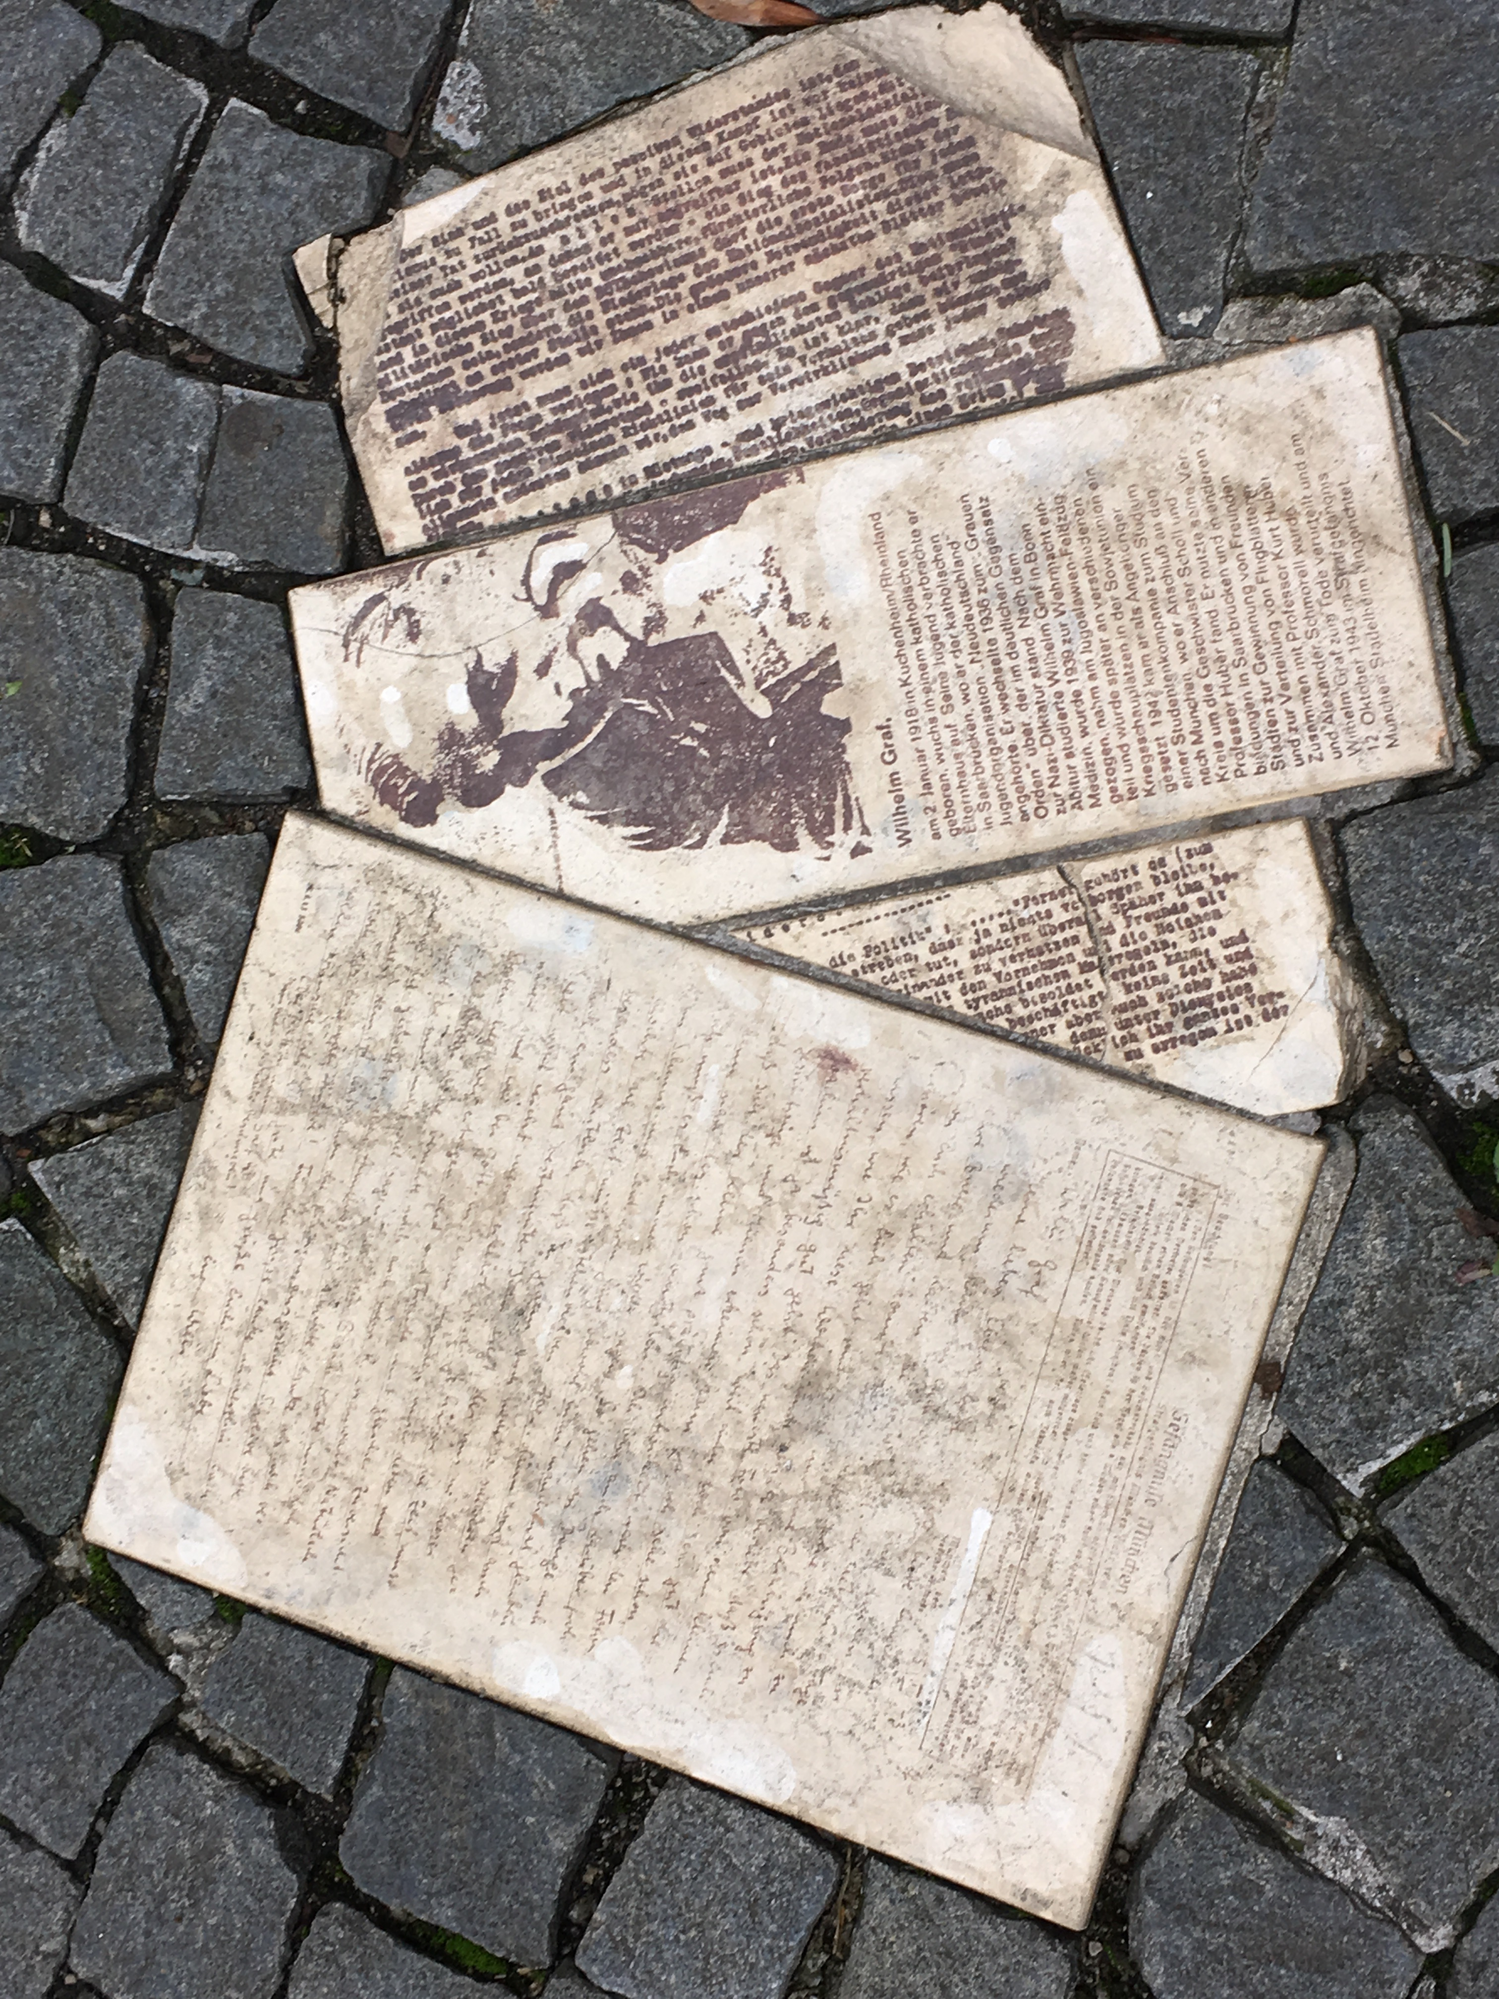
Replica flyers in front of Munich University

Slide 12
Brother & Sister
Hans and Sophie Scholl, and the many other members of the White Rose and other youth resistance groups in Germany did not experience that “grace”. They experienced the burden of responsibility, they recognized it and, in some cases, as we will see they died for it.

Slide 13
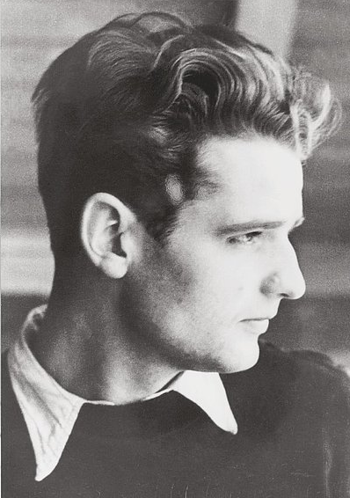
Hans Scholl (1918-43) Sophie Scholl (1921-43)

Slide 14
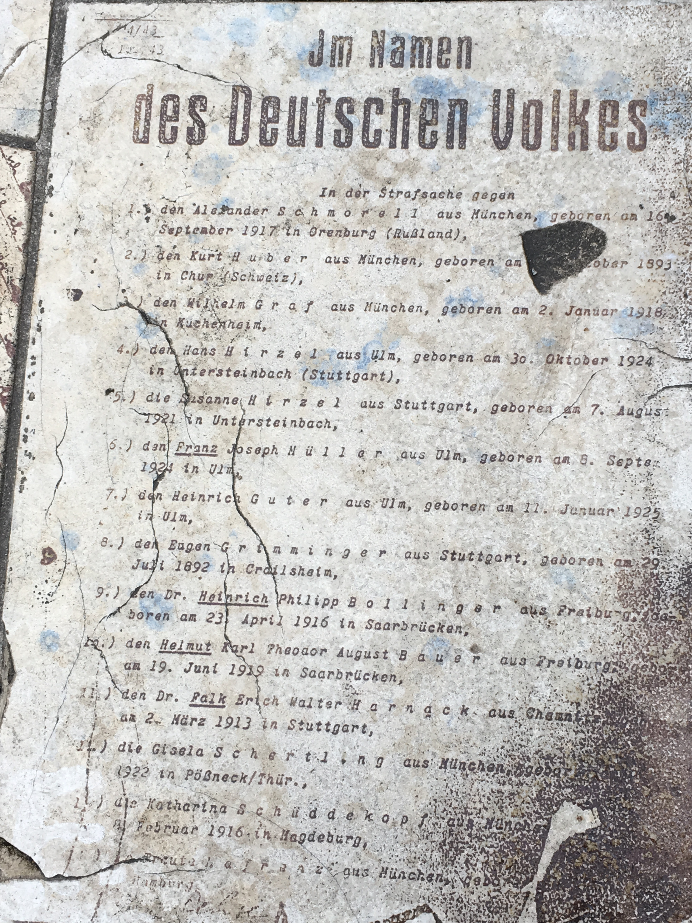
Court document from “proceedings” against members of the White Rose

Slide 15
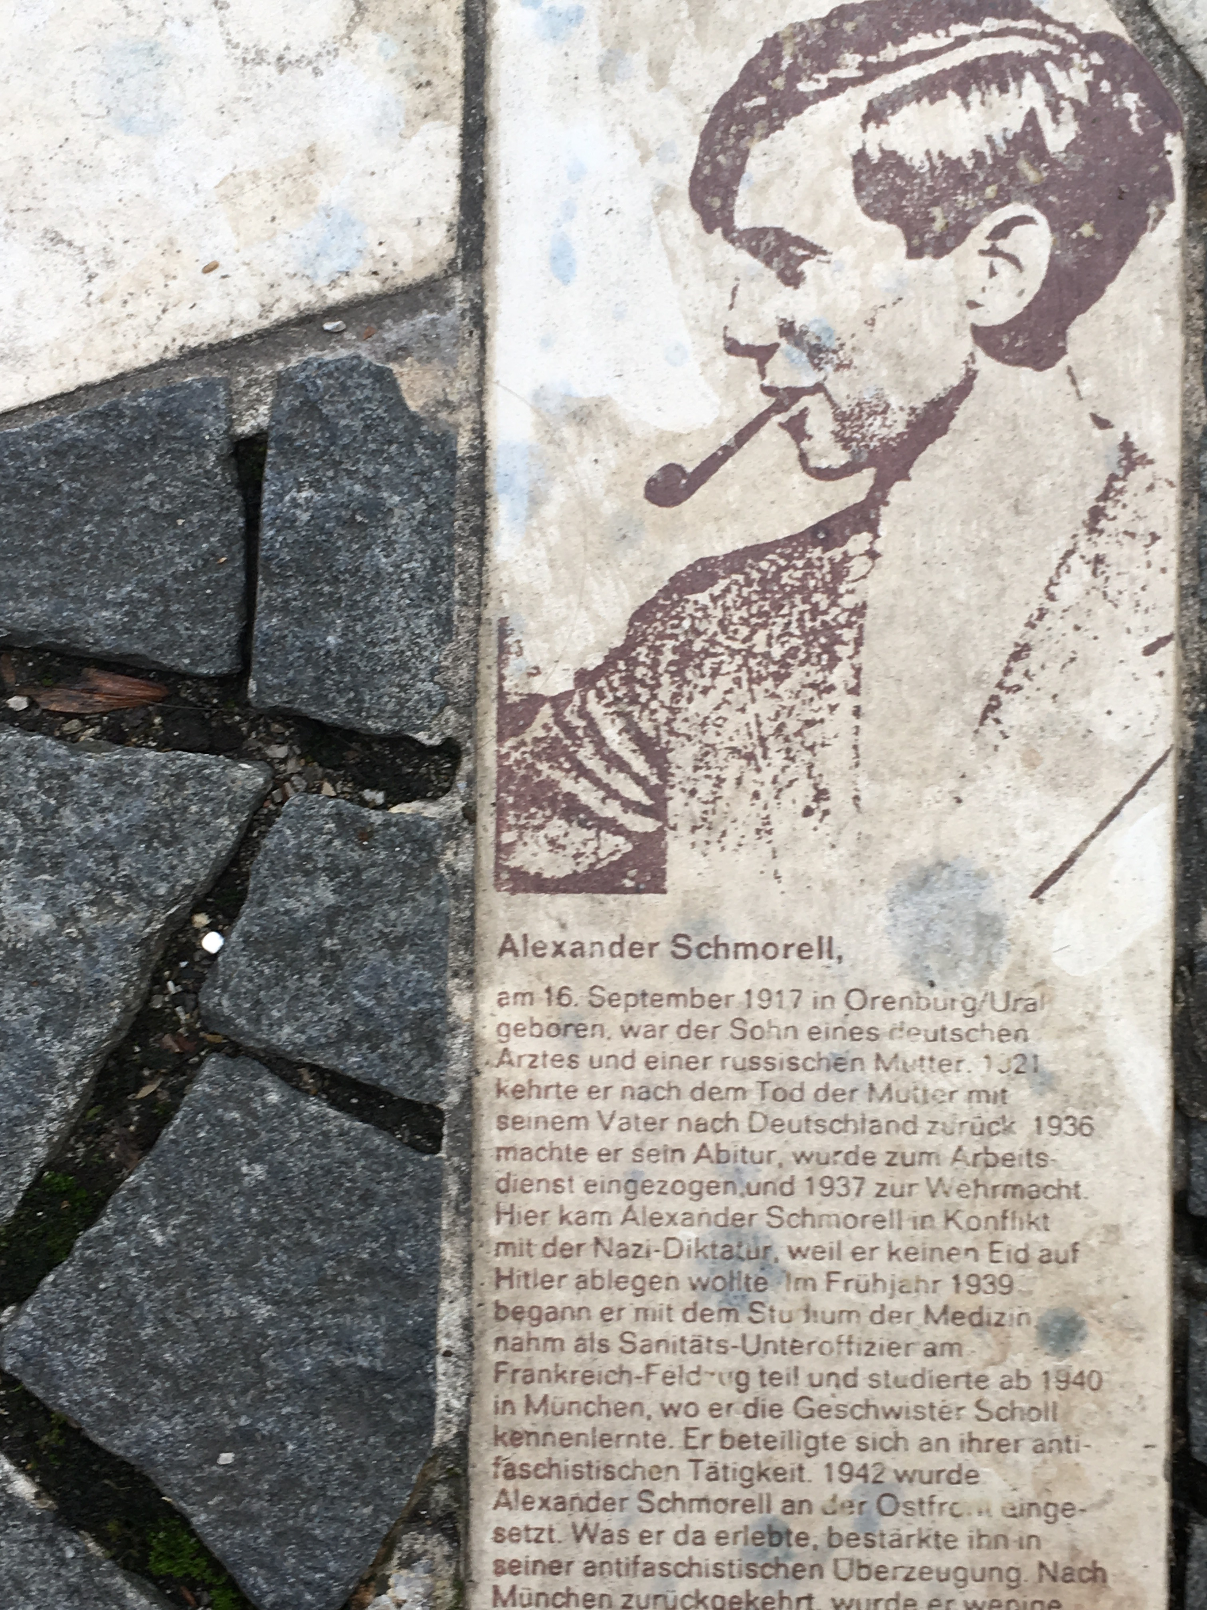
Alexander Schmorell

Slide 16
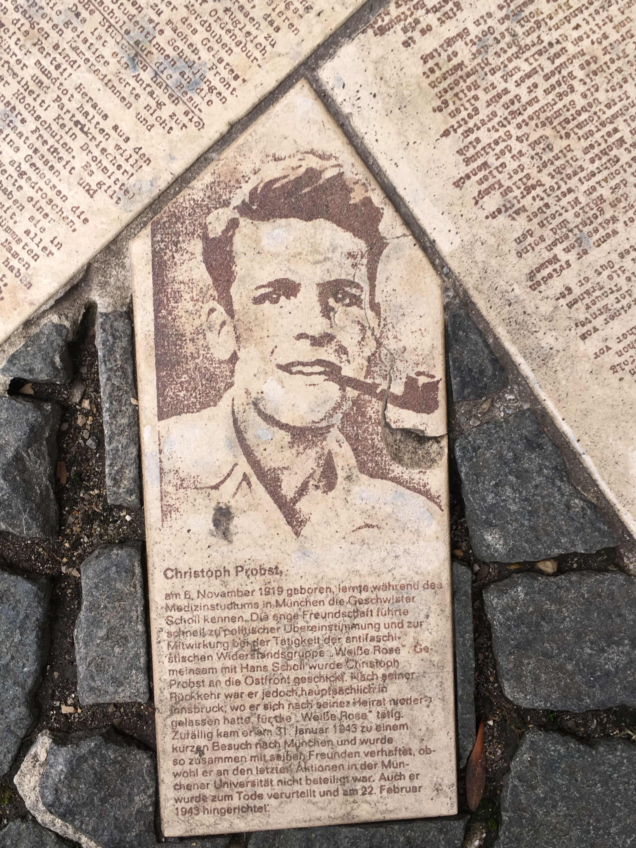
Christoph Propst

Slide 17
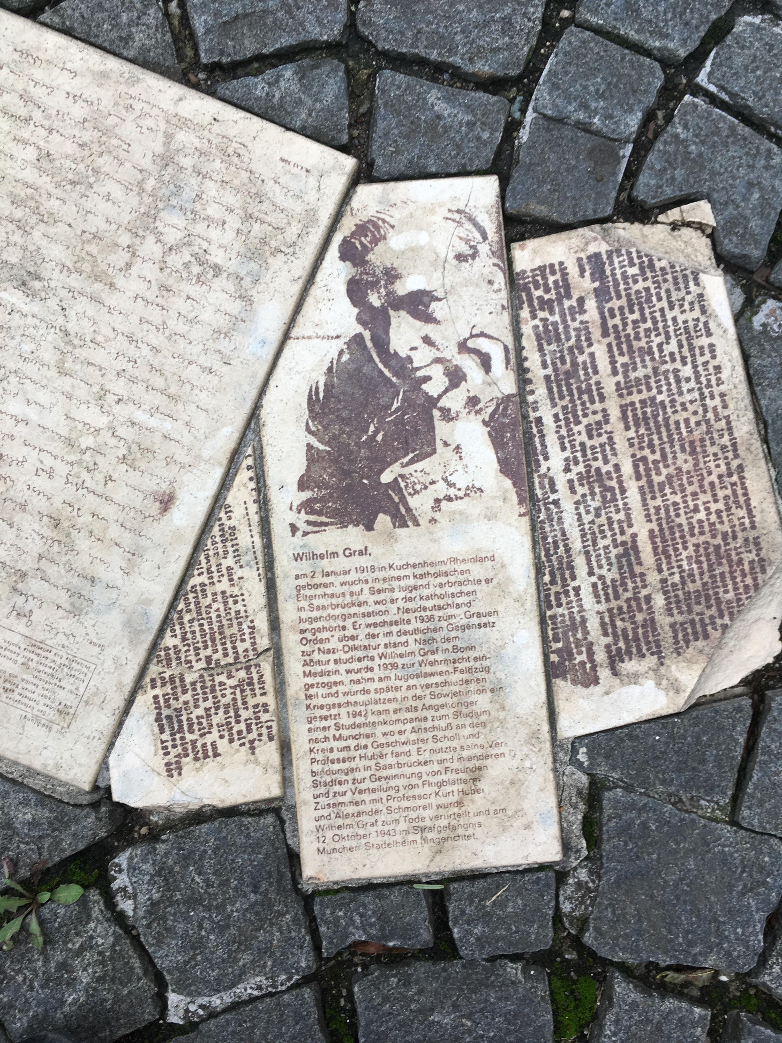

Slide 18
Willi Graf

Slide 19
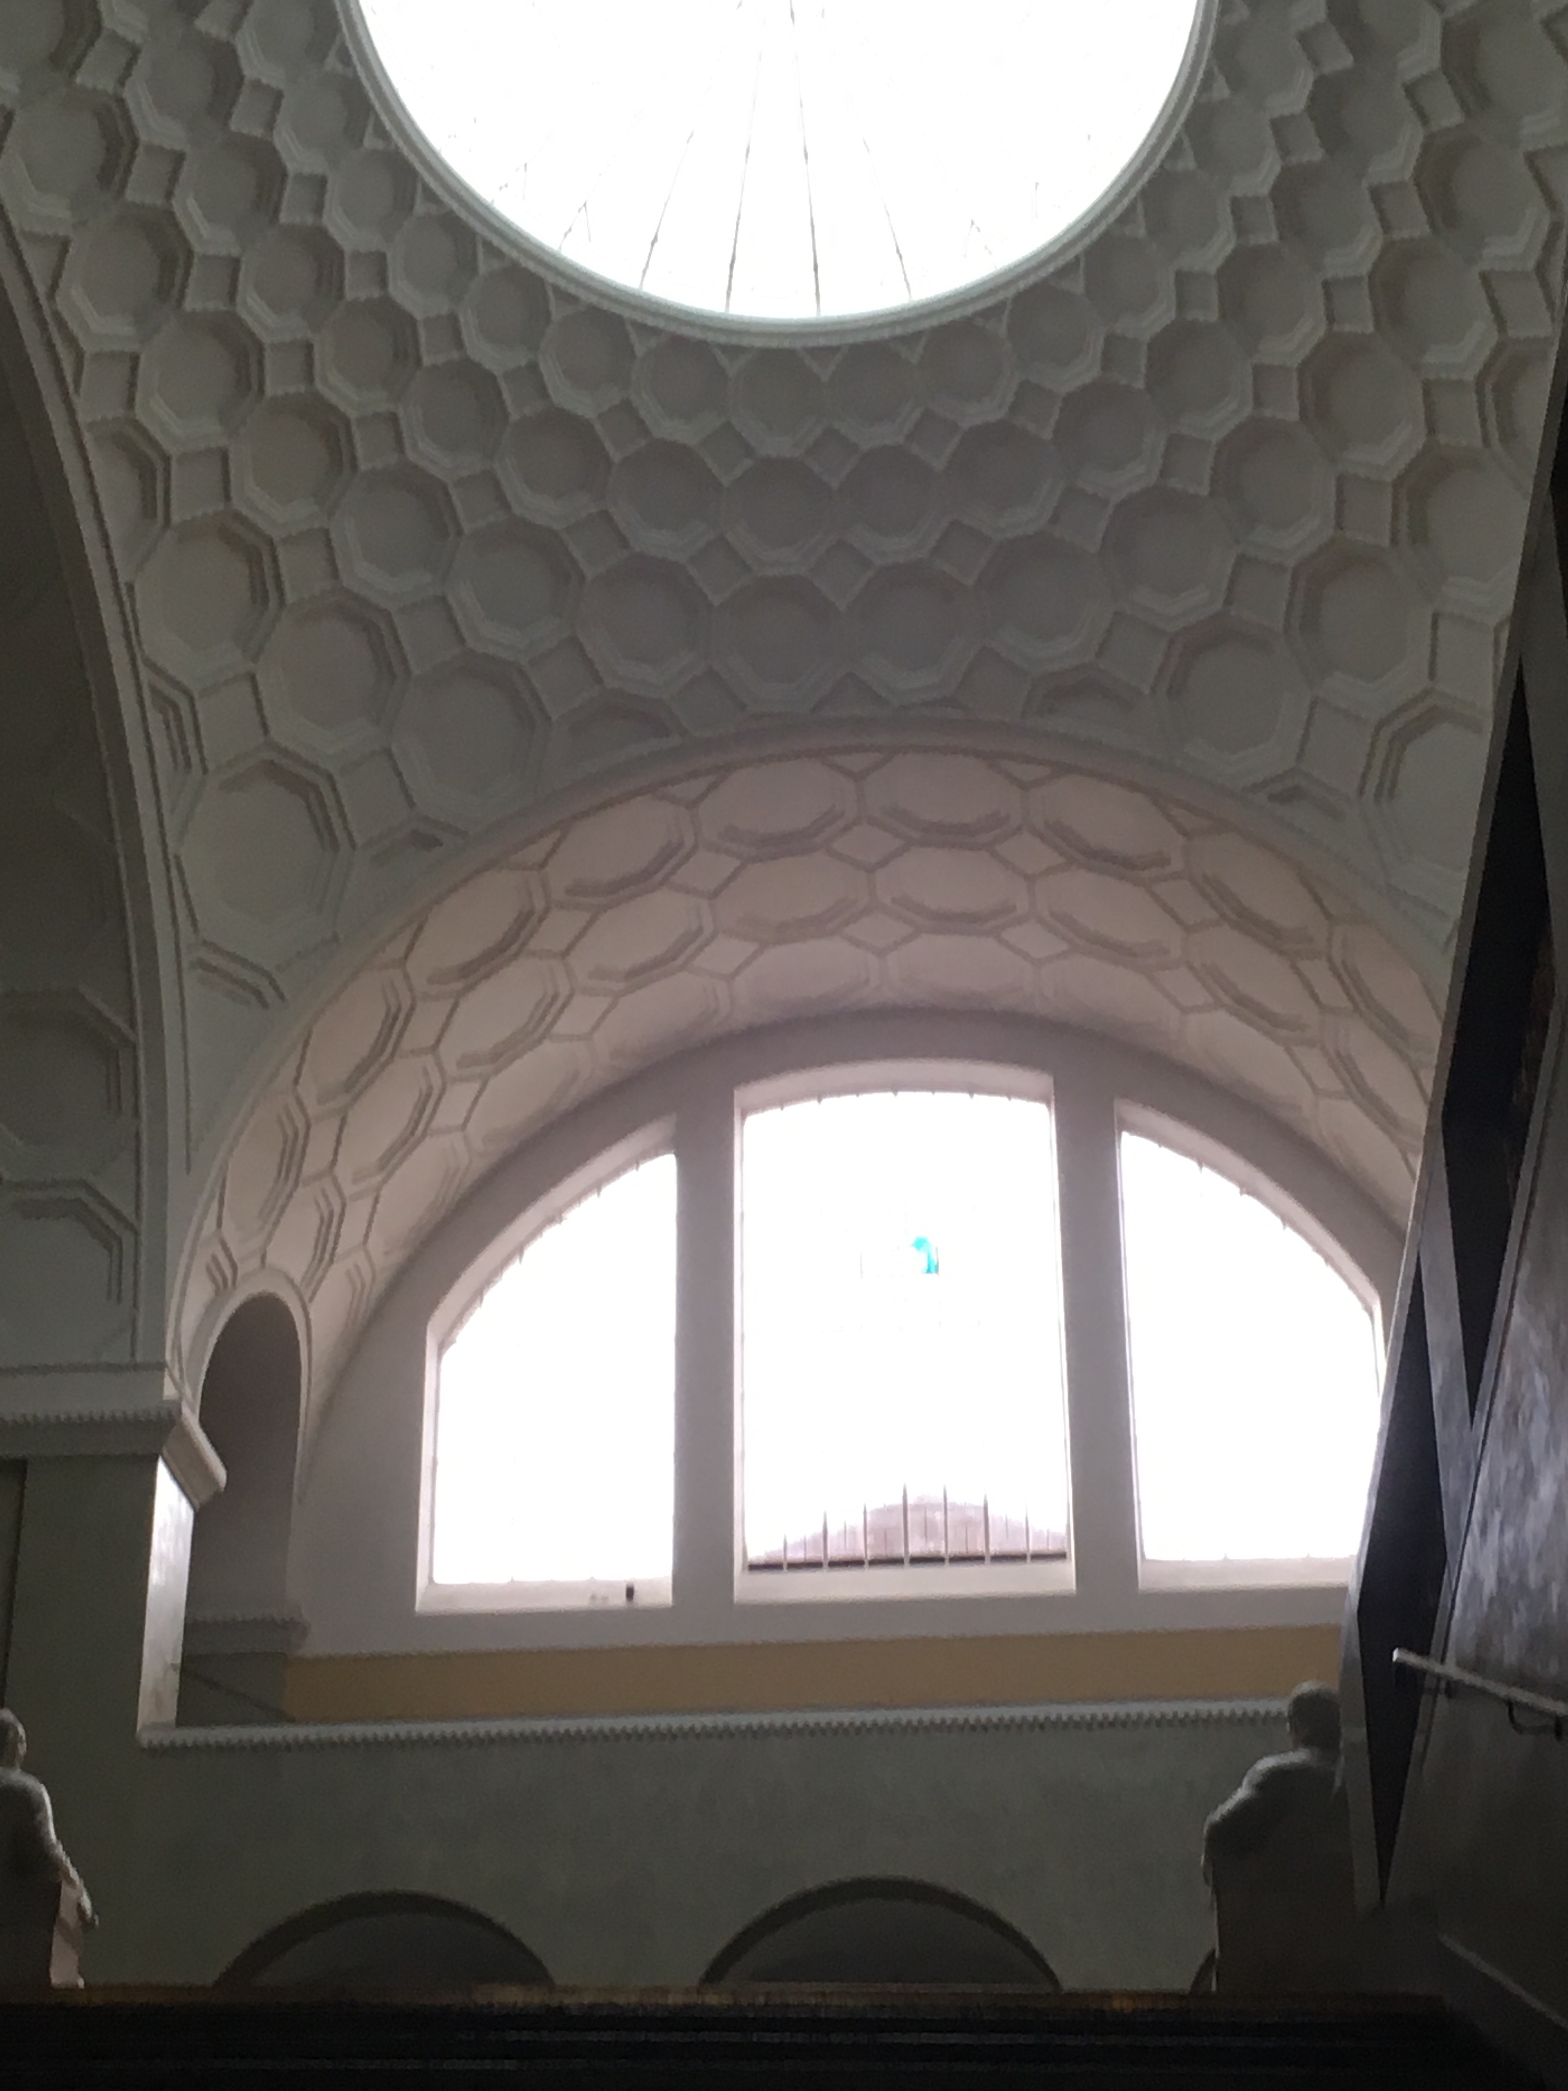
The atrium at Ludwig Maximilian University in Munich

Slide 20
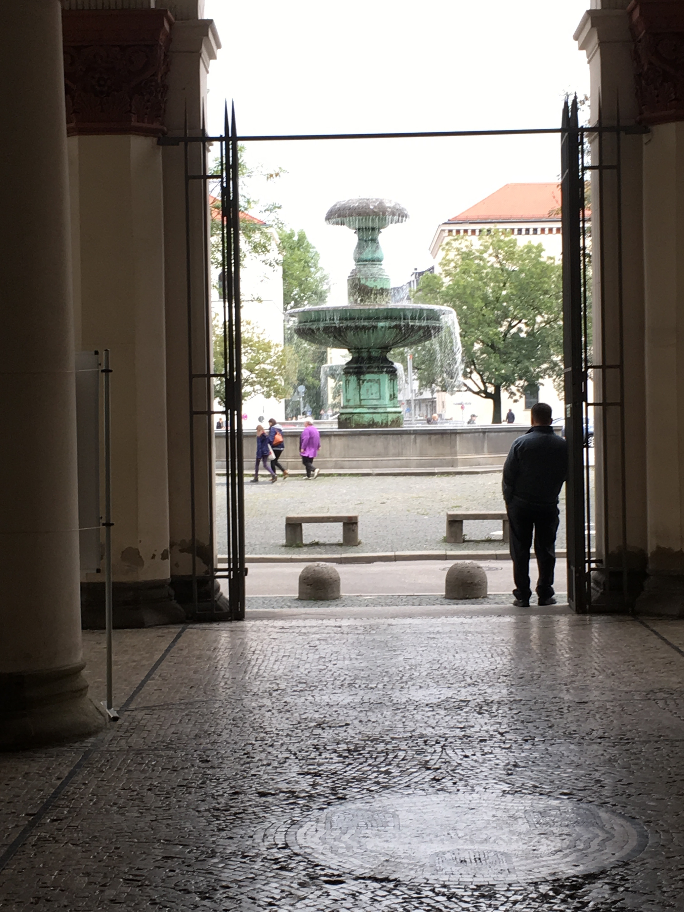
View from main hall to public square in front of university today

Slide 21
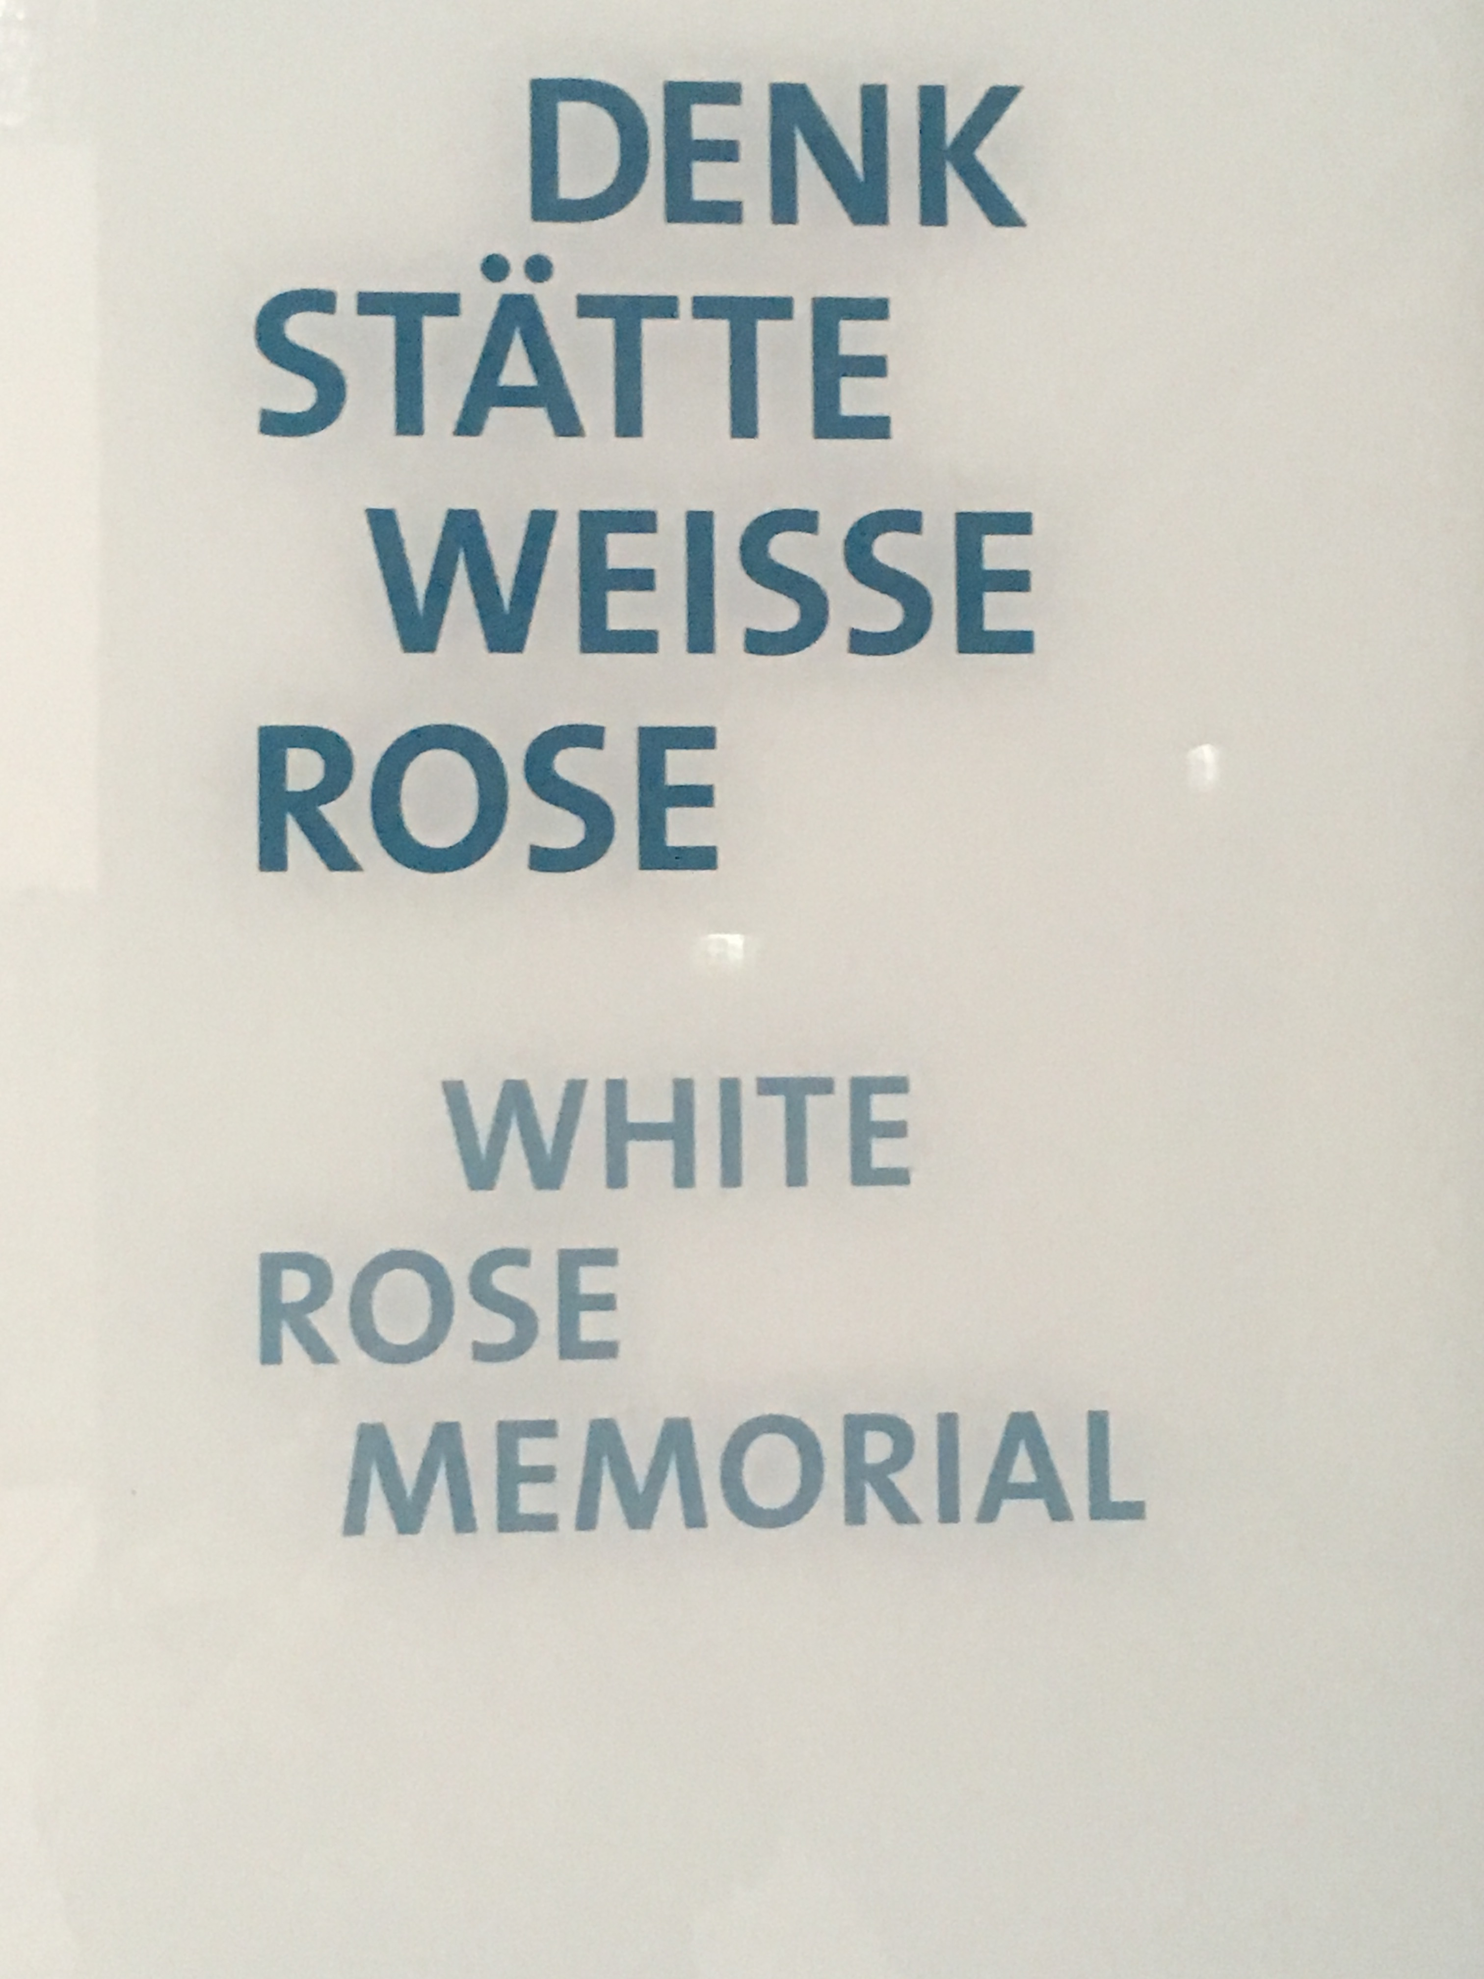
Memorial to the White Rose at Munich University

